Slide 1
INVESTMENT CASE STUDY SUBMISSION
Rashmita Dash

Slide 2
Investment Survey for Spark Funds LLP
Spark Funds LLP, an asset management company, wants to make investments in a few companies.
The Investment Survey aims to analyze global trends in investments so that Spark Funds can take the investment decisions effectively.
Investment study will be confined to following business constraints:
Investment amount needs to be in the range of 5 - 15 million USD per round of funding
Spark Funds LLP aims to invest only in English-speaking countries because of the ease of communication with the companies it would invest in
Spark Fund Aims to Invest in Countries where most of the investments are being made. Specifically the outcome of the survey needs to identify the best sectors, countries, and a suitable investment type for making investments.

Slide 3
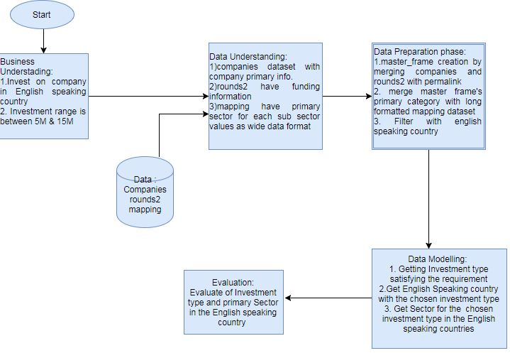
Problem Solving Methodology

Slide 4
Investment Type Analysis
Objectives:
Analysis for understanding investments in Funding Rounds Type such as - venture, seed/angel, private equity categories, etc.
Idenify best suited Funding Round Type
Analysis Steps :
Companies Specific investment data is collected in Data Frames
Investment data w.r.t each Funding Round Type such as venture, seed/angel, private equity categories, etc is joined with Companies Specific investment data .
The integration approach in pt 2 is based on matching unique company ids from company investment and funding round data.
The average investment amount is noted for each funding round type in the preferred investment range of 5-15 Million USD.
The highest such value in pt 4 provides the most suitable investment round type.

Slide 5
Country Analysis
Objective:
List the top nine countries which have received the
highest total funding (across ALL sectors for the most suitable investment type)
Find the top 3 English Speaking Countries that have received the highest total funding
Analysis Steps :
Group the master_frame per country and arrange as per highest total funding (across ALL sectors for the most suitable investment type)
Out of the top 9 nine countries identified in pt 1, identify what countries are having the official language as English and deriving the top 3 such countries in the order of the total investment made

Slide 6
Sector Analysis
Objective:
Analyze distribution of investments across the eight main sectors.
Analysis Steps :
Convert the mapping file that maps one investment category to a sector from wide to long format for sector analysis. Prep the master frame to populate the primary category from the category list.
Populate sector information into the master data frame containing investment data by joining mapping file’s primary category with master data frame primary category.
Apply business constraints such funding amount range to data obtained in pt 2
Evaluate the following:
Total number of investments (count)
Total amount of investment (USD)
Top sector (based on count of investments)
Second-best sector (based on count of investments)
Third-best sector (based on count of investments)
Number of investments in the top sector (refer to point 3)
Number of investments in the second-best sector (refer to point 4)
Number of investments in the third-best sector (refer to point 5)
For the top sector count-wise (point 3), which company received the highest investment?
For the second-best sector count-wise (point 4), which company received the highest investment?

Slide 7
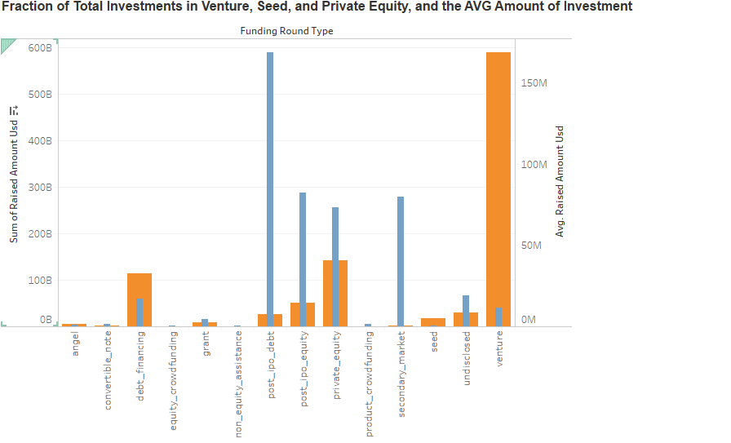
Total Investments w.r.t Average Investment Amount Per Funding Round Type (FT)
Plot 1
Total Investments
per FT(Orange)
Average Investment Amount
Per FT (Blue)

Slide 8
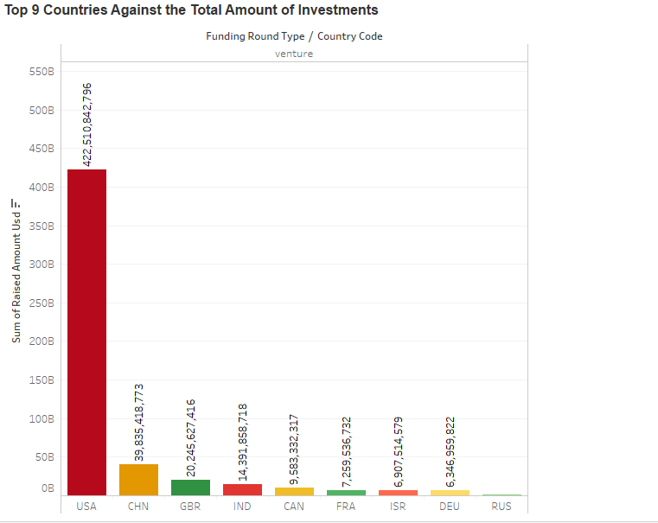
Investment Amount Raised Top 9 Countries
Plot 3
Top 9 Favourite Countries
For Investment in
Venture Funding Round Type.

Slide 9
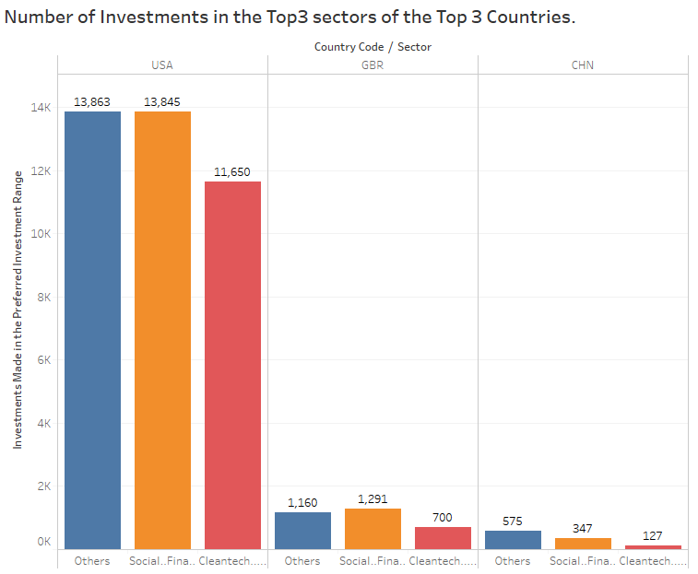
Top 3 Sectors for Investments in Top 3 Investor Favourite Countries
Plot 3
Bar Chart Showing
Top 3 Funding Sectors for
Top 3 Investor Favourite
Countries

Slide 10
Conclusions
[1] Most Suitable Investment Round Type is Venture
[2] The top 9 countries which have received the highest total funding across ALL sectors for the most suitable investment type are the following:
USA,CHN,GBR,IND,CAN,FRA,ISR,DEU,RUS
[3]Top 3 English Speaking Countries for Investment – USA,GBR, IND
[4] Top 3 Sectors for Investment – Others(miscellaneous),Social..Finance..Analytics..Advertising, Cleantech..Semiconductors

